Slide 1
ARTIFICIAL NEURAL NETWORKS
Name of the Presenter: Pradeep Bilurkar

Slide 2
Outline
Introduction
Biological Background
Neural Network Representation
Learning Algorithm
Neural Network Application Development
Benefits and limitations of ANN
Neural Network Applications

Slide 3
Artificial Neural Network -Definition
A Artificial neural network is a massive parallel distributed processor made up of simple processing units, which has a natural propensity for storing experimental knowledge and making it available for use. It resembles the brain in two respects:
Knowledge is acquired by the network from its environment through a learning process.
Inter-neuron connection strengths, known as synaptic weights, are used to store the acquired knowledge.

Slide 4
Biological Motivation
Human brain is a densely interconnected network of approximately 10¹¹ neurons, each connected to, on average, 10⁴ others.
Neuron activity is excited or inhibited through connections to other neurons.
The fastest neuron switching times are known to be on the order of 10⁻³ sec.

Slide 5
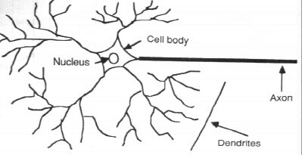
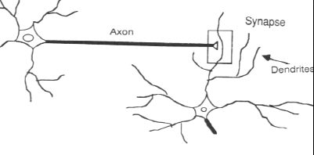
The cell itself includes a nucleus (at the center).
To the right of cell 2, the dendrites provide input signals to the cell.
To the right of cell 1, the axon sends output signals to cell 2 via the axon terminals. These axon terminals merge with the dendrites of cell 2.
Axons = the transmission lines
Dendrites = the receptive zones
Action potentials, spikes
originate at the cell body of neurons and then propagate across the individual neurons at constant velocity and amplitude

Slide 6
Portion of a network: two interconnected cells.
Signals can be transmitted unchanged or they can be altered by synapses. A synapse is able to increase or decrease the strength of the connection from the neuron to neuron and cause excitation or inhibition of a subsequence neuron. This is where information is stored.
The information processing abilities of biological neural systems must follow from highly parallel processes operating on representations that are distributed over many neurons. One motivation for ANN is to capture this kind of highly parallel computation based on distributed representations.

Slide 7
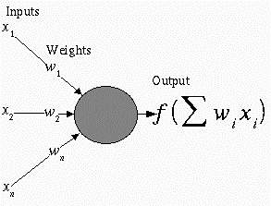
Neural Network Representation
An ANN is composed of processing elements called or perceptrons, organized in different ways to form the network’s structure.
Processing Elements
An ANN consists of perceptrons. Each of the perceptrons receives inputs, processes inputs and delivers a single output.
The input can be raw input data or the output of other perceptrons.
The output can be the final result (e.g. 1 means yes, 0 means no) or it can be inputs to other perceptrons.

Slide 8
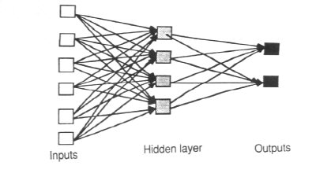
The network
Each ANN is composed of a collection of perceptrons grouped in layers. A typical structure is shown in Fig
Note the three layers: input, intermediate (called the hidden layer) and output.
Several hidden layers can be placed between the input and output layers.

Slide 9
The Neuron
The neuron is the basic information processing unit of a NN. It consists of:
A set of synapses or connecting links, each link characterized by a weight:
W₁, W₂, …, W_{m}
An adder function (linear combiner) which computes the weighted sum of the inputs:
Activation function (squashing function) for limiting the amplitude of the output of the neuron.

Slide 10
The Neuron
Bias
b
x₁
w₁
Activation
function
Local
Field
v
Output
y
Input
signal
x₂
w₂
Summing
function
x_{m}
w_{m}
Synaptic
weights

Slide 11
Common Activation Functions
Step function:
g(x)=1, if x >= t ( t is a threshold)
g(x) = 0, if x < t
Sign function:
g(x)=1, if x >= t ( t is a threshold)
g(x) = -1, if x < t
Sigmoid function: g(x)= 1/(1+exp(-x))

Slide 12

Sigmoid function
The sigmoid function σ(x) is also called the logistic function.
Interesting property:
Output ranges between 0 and 1, increasing monotonically with its input.

Slide 13
Appropriate Problems for Neural Network
ANN learning is well-suited to problems in which the training data corresponds to noisy, complex sensor data. It is also applicable to problems for which more symbolic representations are used.
The backpropagation (BP) algorithm is the most commonly used ANN learning technique. It is appropriate for problems with the characteristics:
Input is high-dimensional discrete or real-valued (e.g. raw sensor input)
Output is discrete or real valued
Output is a vector of values
Possibly noisy data
Long training times accepted
Fast evaluation of the learned function required.
Not important for humans to understand the weights
Examples:
Speech phoneme recognition
Image classification
Financial prediction

Slide 14
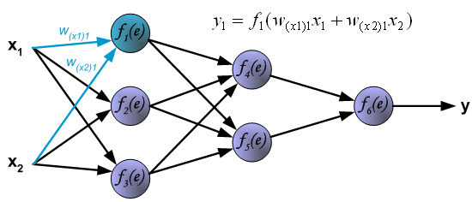
Learning Algorithm: Backpropagation
Pictures below illustrate how signal is propagating through the network, Symbols w_{(xm)n} represent weights of connections between network input x_{m} and neuron n in input layer. Symbols y_{n} represents output signal of neuron n.

Slide 15
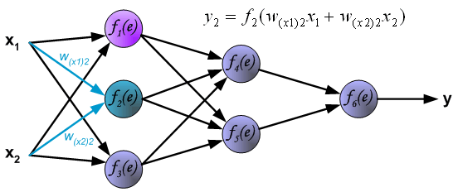
Learning Algorithm: Backpropagation

Slide 16
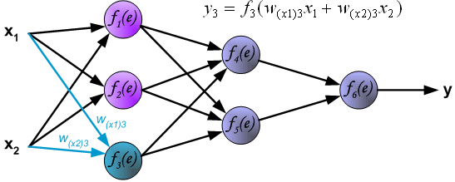
Learning Algorithm: Backpropagation

Slide 17
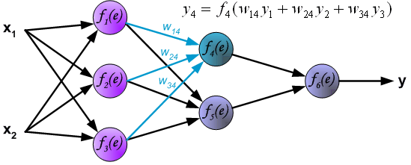
Learning Algorithm: Backpropagation
Propagation of signals through the hidden layer. Symbols w_{mn} represent weights of connections between output of neuron m and input of neuron n in the next layer.

Slide 18
Learning Algorithm: Backpropagation

Slide 19
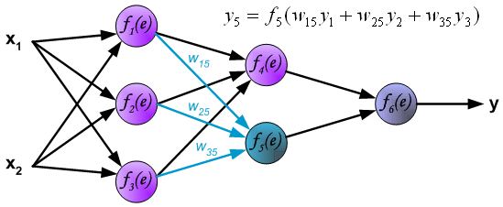
Learning Algorithm: Backpropagation

Slide 20
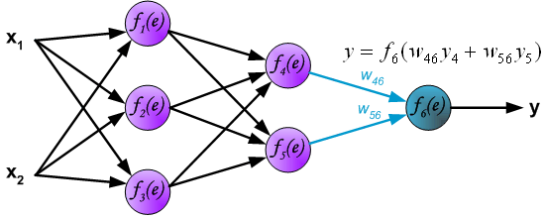
Learning Algorithm: Backpropagation
Propagation of signals through the output layer.

Slide 21
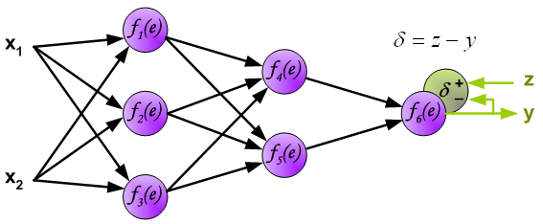
Learning Algorithm: Backpropagation
In the next algorithm step the output signal of the network y is compared with the desired output value (the target), which is found in training data set. The difference is called error signal d of output layer neuron

Slide 22
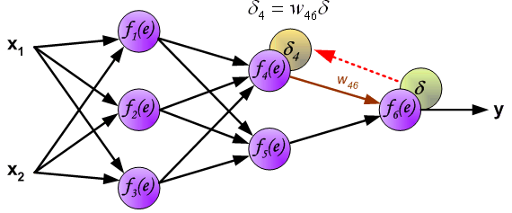
Learning Algorithm: Backpropagation
The idea is to propagate error signal d (computed in single teaching step) back to all neurons, which output signals were input for discussed neuron.

Slide 23
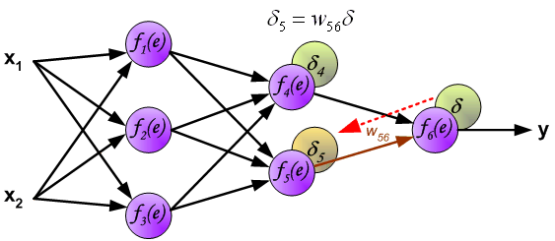
Learning Algorithm: Backpropagation
The idea is to propagate error signal d (computed in single teaching step) back to all neurons, which output signals were input for discussed neuron.

Slide 24
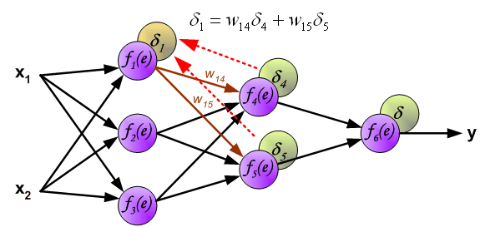
Learning Algorithm: Backpropagation
The weights' coefficients w_{mn} used to propagate errors back are equal to this used during computing output value. Only the direction of data flow is changed (signals are propagated from output to inputs one after the other). This technique is used for all network layers. If propagated errors came from few neurons they are added. The illustration is below:

Slide 25
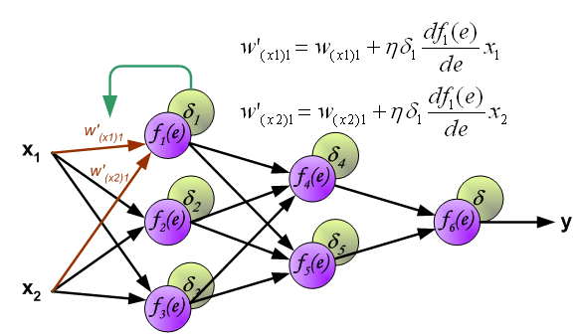
Learning Algorithm: Backpropagation
When the error signal for each neuron is computed, the weights coefficients of each neuron input node may be modified. In formulas below df(e)/de represents derivative of neuron activation function (which weights are modified).

Slide 26
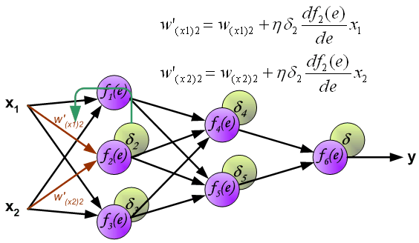
Learning Algorithm: Backpropagation
When the error signal for each neuron is computed, the weights coefficients of each neuron input node may be modified. In formulas below df(e)/de represents derivative of neuron activation function (which weights are modified).

Slide 27
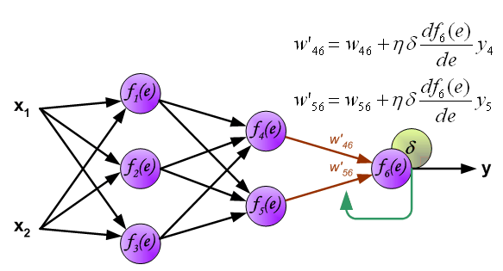
Learning Algorithm: Backpropagation
When the error signal for each neuron is computed, the weights coefficients of each neuron input node may be modified. In formulas below df(e)/de represents derivative of neuron activation function (which weights are modified).

Slide 28
Backpropagation in equations I
If j is a node in an output layer, the error δj is:
δj = (tj - aj) aj(aj -1)
where aj is the activation of node j
tj is its target activation value, and
δj its error value

Slide 29
Backpropagation in equations II
If j is a node in a hidden layer, and if there are k nodes 1, 2, …, k, that receive a connection from j, the error δj is:
δj = (w1j δ1 + w2j δ2 + … + wkjδk) aj (aj -1)
where the weights w1j , w2j , …, wkj belong to the connections from hidden node j to nodes 1, 2, …, k.

Slide 30
Backpropagation in equations III
The backpropagation learning rule (applied at time t) is:
Δwji(t) = μ δjai + βΔwji(t-1)
where Δwji (t) is the change in the weight from node i to node j at time t,
The learning constant μ is typically chosen rather small (e.g., 0.05).
The momentum term β is typically chosen around 0.5.

Slide 31
Neural Network Application Development
The development process for an ANN application has eight steps.
Step 1: (Data collection) The data to be used for the training and testing of the network are collected. Important considerations are that the particular problem is amenable to neural network solution and that adequate data exist and can be obtained.
Step 2: (Training and testing data separation) Trainning data must be identified, and a plan must be made for testing the performance of the network. The available data are divided into training and testing data sets. For a moderately sized data set, 80% of the data are randomly selected for training, 10% for testing, and 10% secondary testing.
Step 3: (Network architecture) A network architecture and a learning method are selected. Important considerations are the exact number of perceptrons and the number of layers.

Slide 32
Step 4: (Parameter tuning and weight initialization) There are parameters for tuning the network to the desired learning performance level. Part of this step is initialization of the network weights and parameters, followed by modification of the parameters as training performance feedback is received.
Often, the initial values are important in determining the effectiveness and length of training.
Step 5: (Data transformation) Transforms the application data into the type and format required by the ANN.
Step 6: (Training) Training is conducted iteratively by presenting input and desired or known output data to the ANN. The ANN computes the outputs and adjusts the weights until the computed outputs are within an acceptable tolerance of the known outputs for the input cases.

Slide 33
Step 7: (Testing) Once the training has been completed, it is necessary to test the network.
The testing examines the performance of the network using the derived weights by measuring the ability of the network to classify the testing data correctly.
Black-box testing (comparing test results to historical results) is the primary approach for verifying that inputs produce the appropriate outputs.
Step 8: (Implementation) Now a stable set of weights are obtained.
Now the network can reproduce the desired output given inputs like those in the training set.
The network is ready to use as a stand-alone system or as part of another software system where new input data will be presented to it and its output will be a recommended decision.

Slide 34
Benefits and Limitations of Neural Network
Benefits of ANNs
Usefulness for pattern recognition, classification, generalization, abstraction and interpretation of imcomplete and noisy inputs.
(e.g. handwriting recognition, image recognition, voice and speech recognition, weather forecasing).
Providing some human characteristics to problem solving that are difficult to simulate using the logical, analytical techniques of expert systems and standard software technologies.
(e.g. financial applications).
Robustness. ANNs tend to be more robust than their conventional counterparts. They have the ability to cope with imcomplete or fuzzy data. ANNs can be very tolerant of faults if properly implemented.

Slide 35
Fast processing speed. Because they consist of a large number of massively interconnected processing units, all operating in parallel on the same problem, ANNs can potentially operate at considerable speed (when implemented on parallel processors).
Flexibility and ease of maintenaince. ANNs are very flexible in adapting their behavior to new and changing environments. They are also easier to maintain, with some having the ability to learn from experience to improve their own performance.
Limitations of ANNs
ANNs do not produce an explicit model even though new cases can be fed into it and new results obtained.
ANNs lack explanation capabilities. Justifications for results is difficults to obtain because the connection weights usually do not have obvious interpretaions.

Slide 36
Some Neural Network Applications
ANN application areas:
Tax form processing to identify tax fraud
Enhancing auditing by finding irregularites
Bankruptcy prediction
Customer credit scoring
Loan approvals
Credit card approval and fraud detection
Financial prediction
Energy forecasting
Computer access security (intrusion detection and classification of attacks)
Fraud detection in mobile telecommunication networks

Slide 37
Customer Loan Approval with Neural Networks - Problem Statement
Many stores are now offering their customers the possibility of applying for a loan directly at the store, so that they can proceed with the purchase of relatively expensive items without having to put up the entire capital all at once.
Initially this practice of offering consumer loans was found only in connection with expensive purchases, such as cars, but it is now commonly offered at major department stores for purchases of washing machines, televisions, and other consumer goods.
The loan applications are filled out at the store and the consumer deals only with the store clerks for the entire process. The store, however, relies on a financial company (often a bank) that handles such loans, evaluates the applications, provides the funds, and handles the credit recovery process when a client defaults on the repayment schedule.

Slide 38
For this study, there were 1000 records of consumer loan applications that were granted by a bank, together with the indication whether each loan had been always paid on schedule or there had been any problem.
The provided data did not make a more detailed distinction about the kind of problem encountered by those “bad” loans, which could range from a single payment that arrived late to a complete defaulting on the loan.
ANN Application to Loan Approval
Each application had 15 variables that included the number of members of the household with an income, the amount of the loan requested, whether or not the applicant had a phone in his/her house, etc.

Slide 39
Table 1: Input and output variables
Input variables Variable values
-----------------------------------------------------------------------------------------------------------------
1 N° of relatives from 1 to total components
2 N° of relatives with job from 0 to total components
3 Telephone number 0,1
4 Real estate 0,1
5 Residence seniority from 0 to date of loan request
6 Other loans 0, 1, 2
7 Payment method 0,1
8 Job type 0,1,2,3
9 Job seniority from 0 to date of loan request
10 Net monthly earnings integer
11 Collateral 0,1,2
12 Loan type 0,1,2,3
13 Amount of loan integer value
14 Amount of installment integer value
15 Duration of loan integer value
-------------------------------------------------------------------------------------------------------------------

Slide 40
Computed output variable
1 Repayment probability from 0 to 100
Desired output variable
1 Real result of grant loan 0 if paymnent irregular or null
100 if payment on schedule
Some of these variables were numerical (e.g. the number of relatives, while other used a digit as a label to indicate a specific class (e.g. the values 0,1,2,3 of variable 8 referred to four different classes of employment).
For each record a single variable indicated whether the loan reached was extinguished without any problem (Z=100) or with some problem (Z=0).
In its a-posteriori analysis, the bank classified loans with Z=0 as “bad loans”. In the provided data, only about 6% of the loans were classified as “bad”. Thus, any ANN that classifies loans from a similar population ought to make errors in a percentage that is substantially lower than 6% to be of any use (otherwise, it could have simply classified all loans as good, resulting in an error on 6% of the cases).

Slide 41
Out of 1000 available records, 400 were randomly selected as a training set for the configuration of the ANN, while the remaining 600 cases were then supplied to the configured ANN so that its computed output could be compared with the real value of variable Z.
Beside the network topology, there are many parameters that must be set. One of the most critical parameters is the number of neurons constituting the hidden layer, as too few neurons can hold up the convergence of the training process, while too many neurons may result in a network that can “learn” very accurately (straight memorization) those cases that are in the training set, but is unable to generalize what has learned to the new cases in the testing set.
The research team selected a network with 10 hidden nodes as the one that provided the most promising performance; the number of iterations was set to 20,000 to allow a sufficient degree of learning, without loss of performance in generalization capability.

Slide 42
The single output of our network turned out to be in the range from -30 to +130, whereas the corresponding “real” output was limited to the values Z=0 or Z=100. A negative value of the output would indicate a very bad loan and thus negative values were clamped to zero; similarly, output values above 100 were assigned the value of 100.
A 30% tolerance was used on the outputs so that loans would be classified as “good” if the ANN computed a value above 70, and “bad” is their output was less then 30. Loans that fell in the intermediate band [30, 70] were left as “unclassified”. The width of this band is probably overly conservative and a smaller one would have sufficed, at the price of possibly granting marginal loans, or refusing loans that could have turned out to be good at the end. The rationale for the existence of the “unclassified” band is to provide an alarm requesting a more detailed examination unforeseen and unpredictable circumstance.

Slide 43
This specific ANN was then supplied with the remaining 600 cases of the testing set.
This set contained 38 cases that had been classified as bad (Z=0), while the remaining 562 cases had been repaid on schedule.
Clearly the ANN separates the given cases into two non-overlapping bands: the good ones near the top and the bad ones near the bottom. No loan was left unclassified, so in this case there would have been no cases requiring additional (human) intervention.
The ANN made exactly three mistakes in the classification of the test cases: those were 3 cases that the ANN classified as “good” loans, whereas in reality they turned out to be “bad”. Manual, a- posteriori inspection of the values of their input variables did not reveal any obvious symptoms that they were “problem cases”.
What could have likely happened is that the applicant did not repay the loan as schedule due to some completely unforeseen and unpredictable circumstance. This is also supported by the fact that the bank officers themselves approved those three loans, thus one must presume that they did not look too risky at application time.

Slide 44
The ANN, however, was more discriminating than the bank officers since the ANN would have denied 35 loan applications that scored less than 30.
As is turns out, all those 35 loans had problems with their repayments and thus the bank would have been well advised to heed the network’s classification and to deny those 35 applications. Had the bank followed that advise, 268 million liras would have not been put in jeopardy by the bank (out of a total of more than 3 billion liras of granted loans that were successfully repaid.)

Slide 45
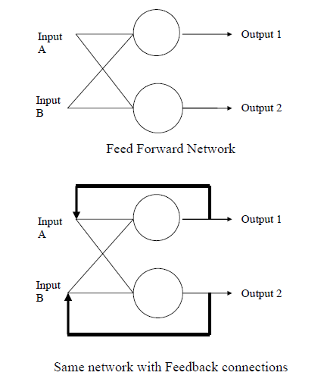
Hopfield Network
What Hopfield did was to add feedback connections to the network (the outputs are
fed back into the inputs) and show that with these connections the networks are
capable of interesting behaviours which we might not expect of them, in particular
they can hold memories.
Networks with such connections are called “feedback” or “recurrent” networks.

Slide 46
Hopfield Network

Slide 47
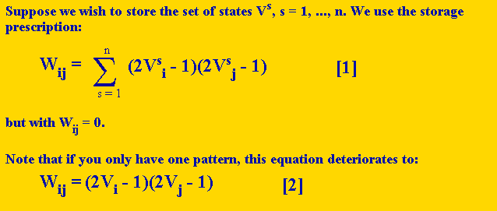

Hopfield Network Training

Slide 48
Hopfield Network Training
For example, say we have a 5 node Hopfield network and we want it to recognize the pattern (0 1 1 0 1). Since there are 5 nodes, we need a matrix of 5 x 5 weights, where the weight from a node back to itself are 0. The weight matrix will look like this:
 | 0 | W₁₂ | W₁₃ | W₁₄ | W₁₅
 | W₂₁ | 0 | W₂₃ | W₂₄ | W₂₅
 | W₃₁ | W₃₂ | 0 | W₃₄ | W₃₅
 | W₄₁ | W₄₂ | W₄₃ | 0 | W₄₅
 | W₅₁ | W₅₂ | W₅₃ | W₅₄ | 0
Since the weights are symmetric, we only have to calculate the upper diagonal of weights, and then we can copy each weight to its inverse weight. In this case, V is the vector (0 1 1 0 1), so V₁ = 0, V₂ = 1, V₃ = 1, V₄ = 0, and V₅ = 1. Thus the computation of the weights is as follows:

Slide 49
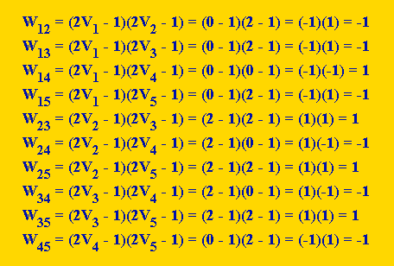
Hopfield Network Training

Slide 50
Hopfield Network Training
So now our weight matrix looks like this:
 | 0 | -1 | -1 | 1 | -1
 | W₂₁ | 0 | 1 | -1 | 1
 | W₃₁ | W₃₂ | 0 | -1 | 1
 | W₄₁ | W₄₂ | W₄₃ | 0 | -1
 | W₅₁ | W₅₂ | W₅₃ | W₅₄ | 0
let's consider the case where we want our 5 node Hopfield net to store both the pattern V¹ = (0 1 1 0 1) and another pattern V² = (1 0 1 0 1). One way you could go about calculating the weights is on a weight by weight basis. For example, W₁₂ could be calculated as:

Slide 51
Hopfield Network Training
 | W₁₂ = | (2V^{s}₁ - 1)(2V^{s}₂ - 1)
 | = | (2V¹₁ - 1)(2V¹₂ - 1) + (2V²₁ - 1)(2V²₂ - 1)
 | = | (2*0 - 1)(2*1 - 1) + (2*1 - 1)(2*0 - 1)
 | = | (0 - 1)(2 - 1) + (2 - 1)(0 - 1)
 | = | (-1)(1) + (1)(-1)
 | = | -1 + -1
 | = | -2
Final Weight Matrix
0 | -2 | 0 | 0 | 0
-2 | 0 | 0 | 0 | 0
0 | 0 | 0 | -2 | 2
0 | 0 | -2 | 0 | -2
0 | 0 | 2 | -2 | 0

Slide 52
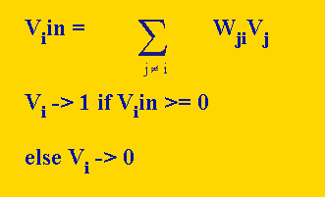
Updating a node in a Hopfield network
Updating a node in a Hopfield network is very much like updating a perceptron. If you are updating node 3 of a Hopfield network, then you can think of that as the perceptron, and the values of all the other nodes as input values, and the weights from those nodes to node 3 as the weights. In other words, first you do a weighted sum of the inputs from the other nodes, then if that value is greater than or equal to 0, you output 1. Otherwise, you output 0

Slide 53
Hopfield Network
What Hopfield did was to add feedback connections to the network (the outputs are
fed back into the inputs) and show that with these connections the networks are
capable of interesting behaviours which we might not expect of them, in particular
they can hold memories.
Networks with such connections are called “feedback” or “recurrent” networks.

Slide 54
Hopfield Network

Slide 55
Hopfield Network
Why use this network? What does it do differently compared to the feedforward networks ? Well, a Hopfield network can reconstruct a pattern from a corrupted original as
This means that the network has been able to store the correct (uncorrupted) pattern – in other words it has a memory. Because of this these networks are sometimes called Associative Memories or Hopfield Memories.

Slide 56
Thank you

Slide 57
Backpropagation Learning
We know that:
Since
We have:
Which gives us:

Slide 58
Backpropagation Learning
For the derivative with regard to w_{j,i}^{(1,0)}, notice that E depends on it through net_{j}⁽¹⁾, which influences each o_{k} with k = 1, …, K:
Using the chain rule of derivatives again:

